Slide 1
X Education - Lead Scoring Case Study
Filtration of convertible leads out of total leads pool so the conversion rate of X education can be improved from 30% to 80%

Slide 2
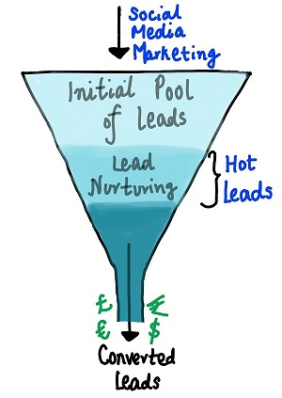
Business Objective
To Increase the leads conversion from 30% to at least 80% by filtering out potential leads.
To create a model that can rank all the leads based on leads score so sales team can prioritize them.

Slide 3
Steps of Analysis
Data Cleaning
EDA
Data Preparation
Model Building
Model Evaluation
Prediction
Recommendation
Data Understanding

Slide 4
Data Understanding and Cleaning
The data have Approx. 9k records with 37 columns.
During Data cleaning process we discovered 7 columns having more than 40% of missing value. These columns were dropped.
Columns such as Lead number and Prospect ID were also dropped as they had unique values for every entry indicating it was an ID column proving no value add in model building.
Imputation was done for categorical columns having missing values.
In numerical columns mode imputation was used for handling missing values.
Categorical columns having skewed data were dropped as they might bias our logistic regression model.

Slide 5
Data Understanding and Cleaning
Winsorization method was used for outliers treatment.
Other cleansing steps
Standardized invalid values.
Encoding was done for categorical variables.
Standard Casing was done for categorical variables.

Slide 6
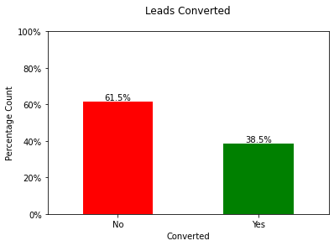
Exploratory Data Analysis (EDA)
Univariate Analysis
38.5% of the people have converted to leads, While 61.5% of the people didn't convert to leads.
This Explains the data is in line with the problem statement given by X Education.

Slide 7
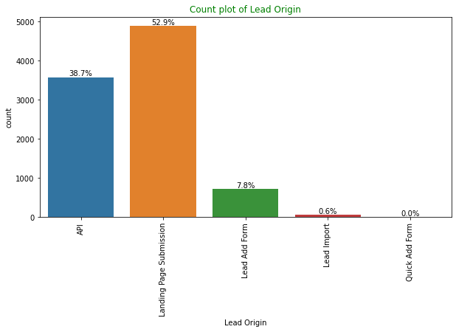
Exploratory Data Analysis (EDA)
Univariate Analysis
The source for 53% of customers is "Landing Page Submission," while "API" accounts for 39%.

Slide 8
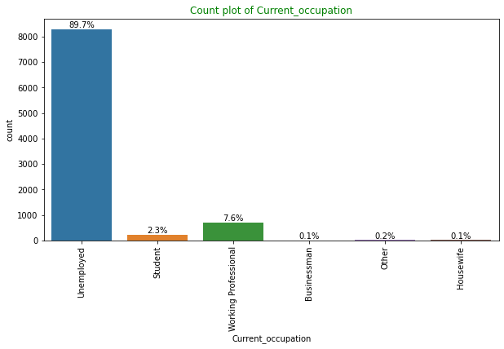
Exploratory Data Analysis (EDA)
Univariate Analysis
Approximately 90% of customers are classified as "Unemployed“.
Rest of the categories are minimal.

Slide 9
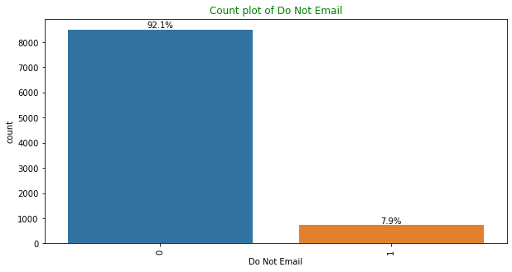
Exploratory Data Analysis (EDA)
Univariate Analysis
Around 92% of individuals have indicated their preference not to receive emails regarding the course.
A collective approach should be given to change this numbers.

Slide 10
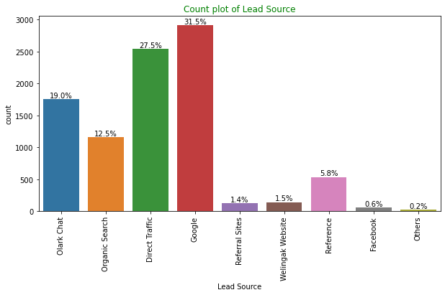
Exploratory Data Analysis (EDA)
Univariate Analysis
The combination of Google and Direct Traffic contributes to 58% of the lead sources.

Slide 11
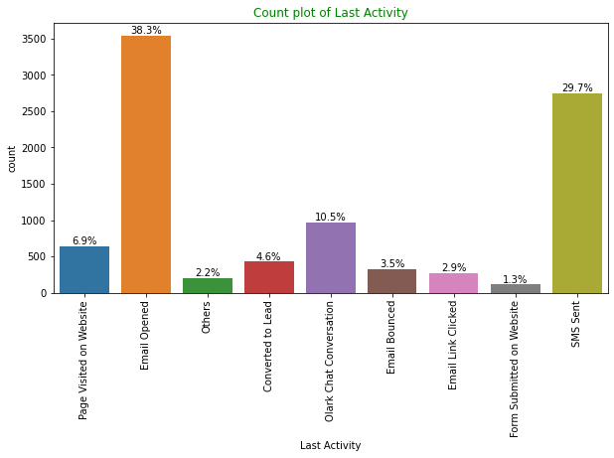
Exploratory Data Analysis (EDA)
Univariate Analysis
The majority of customer interactions, approximately 68%, involve "SMS Sent" and "Email Opened" activities.

Slide 12
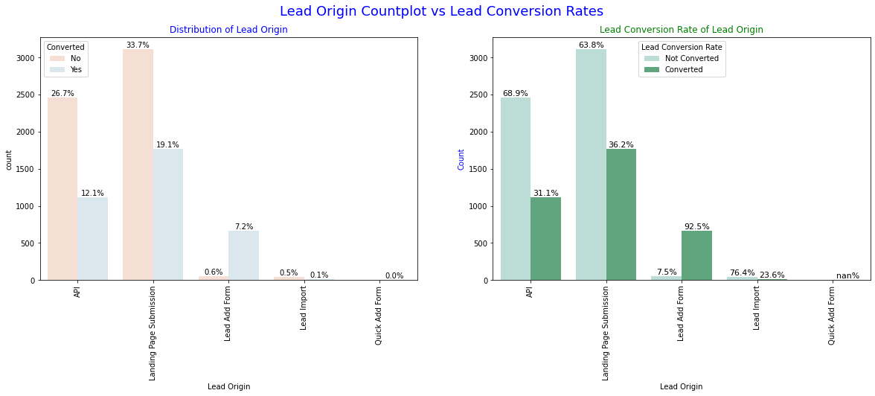
Exploratory Data Analysis (EDA)
Bivariate Analysis
The majority of leads, approximately 52%, were generated through "Landing Page Submission," and these leads had a lead conversion rate (LCR) of 36%. Another source, the "API," accounted for around 39% of customers, with a lead conversion rate (LCR) of 31%.

Slide 13
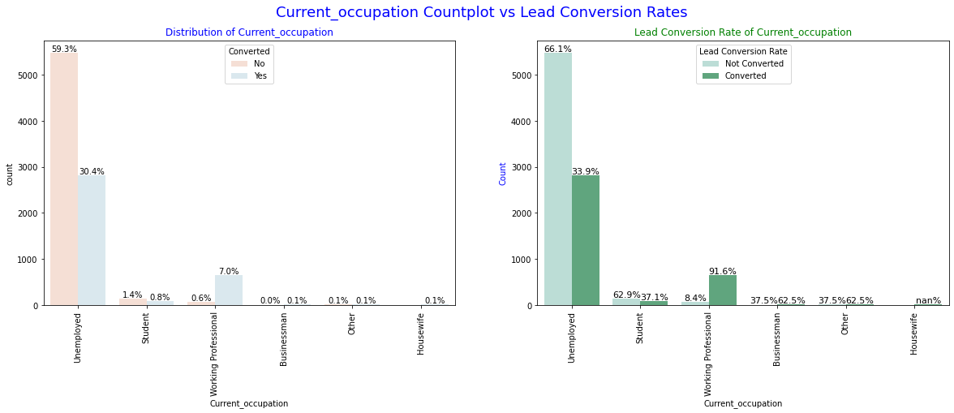
Exploratory Data Analysis (EDA)
Bivariate Analysis
Unemployed individuals comprised approximately 90% of the customer base, and they had a lead conversion rate (LCR) of 34%.
Working Professionals constituted only 7.6% of the total customers but had an impressive lead conversion rate (LCR) of almost 92%.

Slide 14
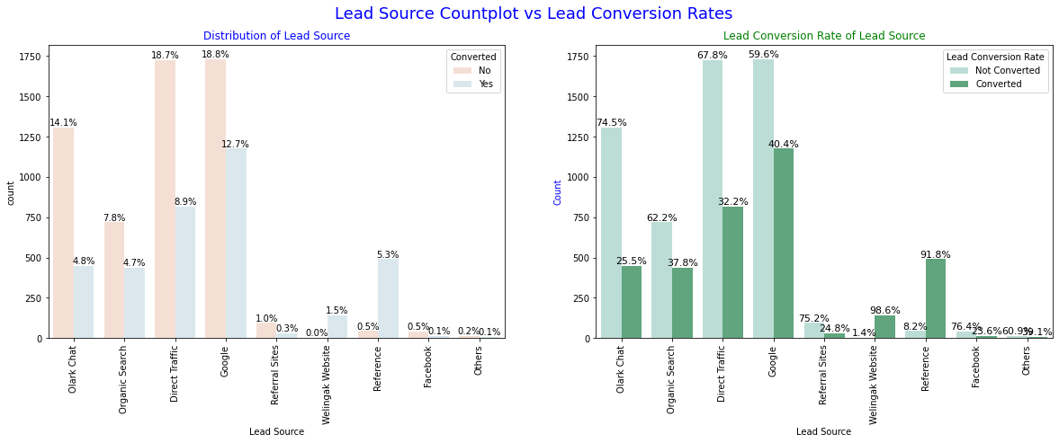
Exploratory Data Analysis (EDA)
Bivariate Analysis
Among the customers, Google has a lead conversion rate (LCR) of 40%, accounting for 31% of the total customers.
Direct Traffic, although contributing to 27% of the customers, has a slightly lower LCR of 32% compared to Google.
Organic Search, on the other hand, yields a higher LCR of 37.8%, but it only represents 12.5% of the customer base.
Reference is an interesting case with a high LCR of 91%, but it only contributes to approximately 6% of the customers.

Slide 15
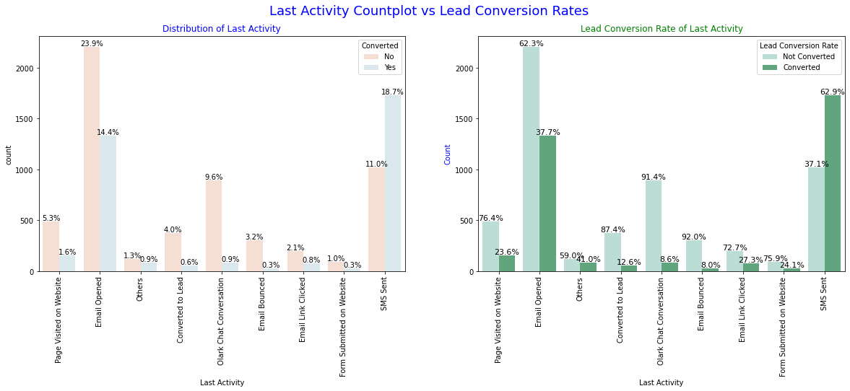
Exploratory Data Analysis (EDA)
Bivariate Analysis
The "SMS Sent" activity stands out with a significant lead conversion rate of 63%, and it is attributed to 30% of the last activities performed by the customers. "Email Opened" represents 38% of the last activities and has a respectable lead conversion rate of 37%.

